Slide 1
The USGS Resource for Advanced Modeling:
Developing an operational capacity
Jeff Morisette Director, DOI North Central Climate Science Center
NASA Biodiversity Team meeting
College Park, MD
Earth Day 2015
1

Slide 2
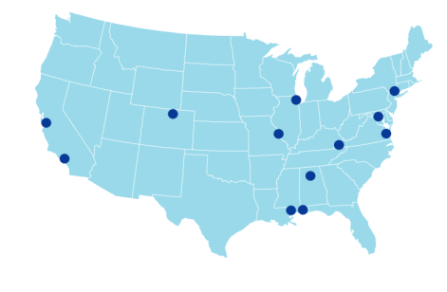
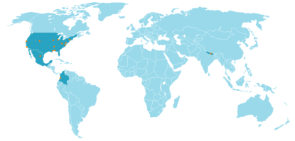
Catherine Jarnevich
Tracy Holcombe
Colin Talbert
Marian Talbert
Team members
USGS-CSU
Resource for
Advanced Modeling
Sunil Kumar
Cam Aldridge
Tom Stohlgren
Dennis Ojima
Tom Hilinski
David Koop
Claudio Silva
Denis Ojima
Andy Hansen
Joe Barsugli
David Blodgett
Emily Fort
Robin O’Malley
Shawn Carter
Doug Beard
Petr Votava
Rama Nemani
Paul Evangelista
2

Slide 3
Outline
Background
Current research themes
Background selection methods
Visualizing response curves
Linking species distribution and simulation modeling
Remote computation of predictor layers
Operational Capacity
Software for Assisted Habitat Modeling (SAHM) training every 6 months
RAM utilization by DOI and other stakeholders
RAM utilization by NASA DEVELOP Central US node
New USGS initiative on Eco-Drought

Slide 4
Outline
Background
Current research themes
Background selection methods
Visualizing response curves
Linking species distribution and simulation modeling
Remote computation of predictor layers
Operational Capacity
Software for Assisted Habitat Modeling (SAHM) training every 6 months
RAM utilization by DOI and other stakeholders
RAM utilization by NASA DEVELOP Central US node
New USGS initiative on Eco-Drought

Slide 5
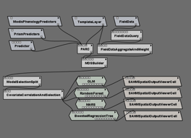
Connecting Climate to Plants and Animals through Ecological Response Modeling
Notes:
Overall components of the species distribution modeling under climate change.
Showing how observations of a species or “management target” at point locations can be merged with “predictor layers” through a modeling algorithm to create a map of suitability.

Slide 6
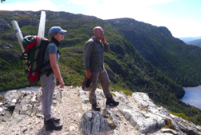
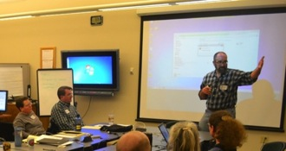
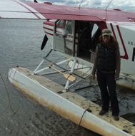
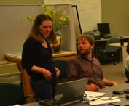
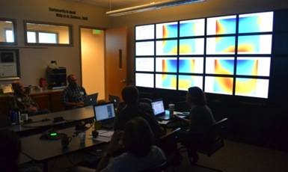
Connecting Climate to Plants and Animals through Ecological Response Modeling
Notes:
It is important to bring experts for each component together in the co-production of knowledge.

Slide 7
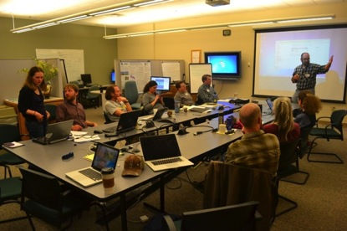
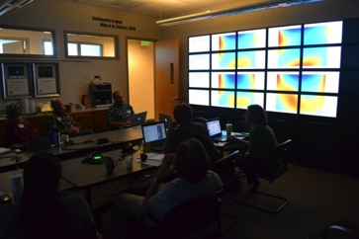
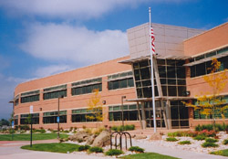
Resource for Advanced Modeling (RAM)
Physical collaborative space
Mini-cluster
~150 processing nodes
VisWall 24 monitors
www.fort.usgs.gov/ram/

Slide 8
Outline
Background
Current research themes
Background selection methods
Visualizing response curves
Linking species distribution and simulation modeling
Remote computation of predictor layers
Operational Capacity
Software for Assisted Habitat Modeling (SAHM) training every 6 months
RAM utilization by DOI and other stakeholders
RAM utilization by NASA DEVELOP Central US node
New USGS initiative on Eco-Drought

Slide 9
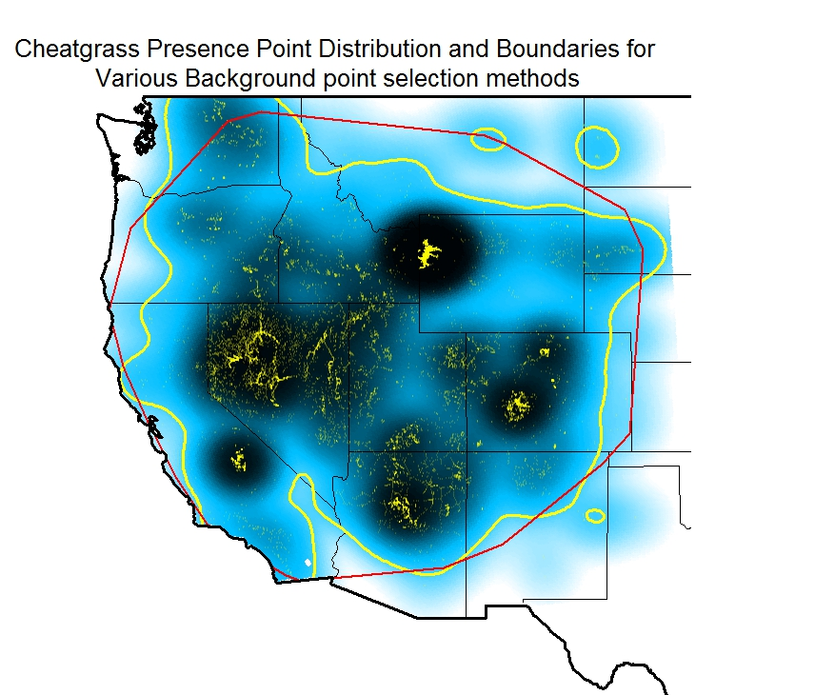
Research: Background and Modeling options, Cheat grass example
random (across study area)
minimum convex polygon (MCP) (red)
kernel/sample density (KDE)
continuous (color ramp) or binary (yellow)

Slide 10
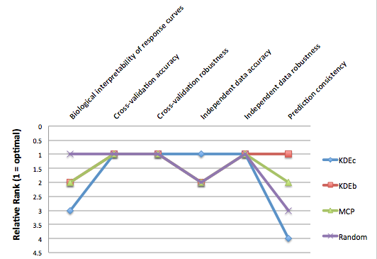
Research: Background and Modeling options, Cheat grass example

Slide 11
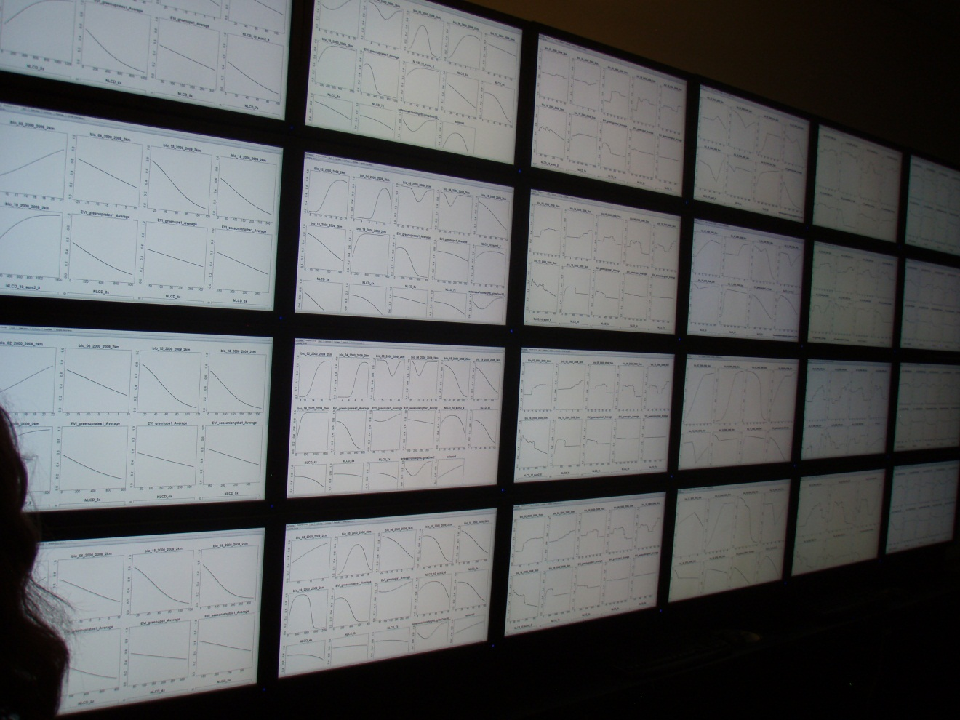
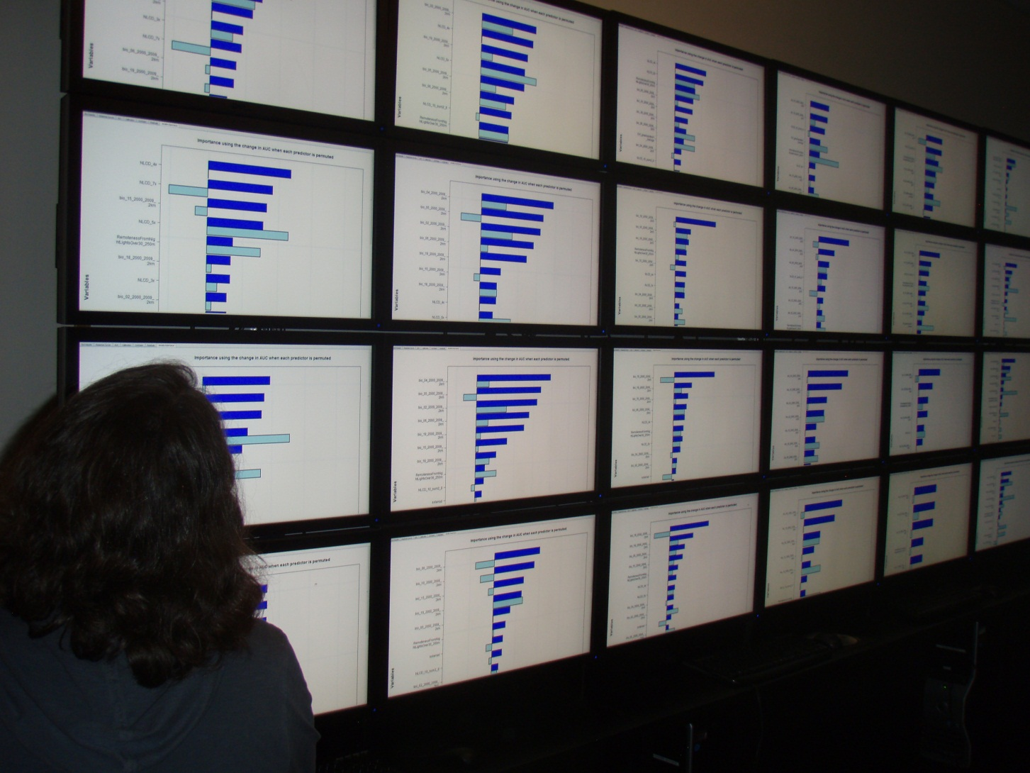
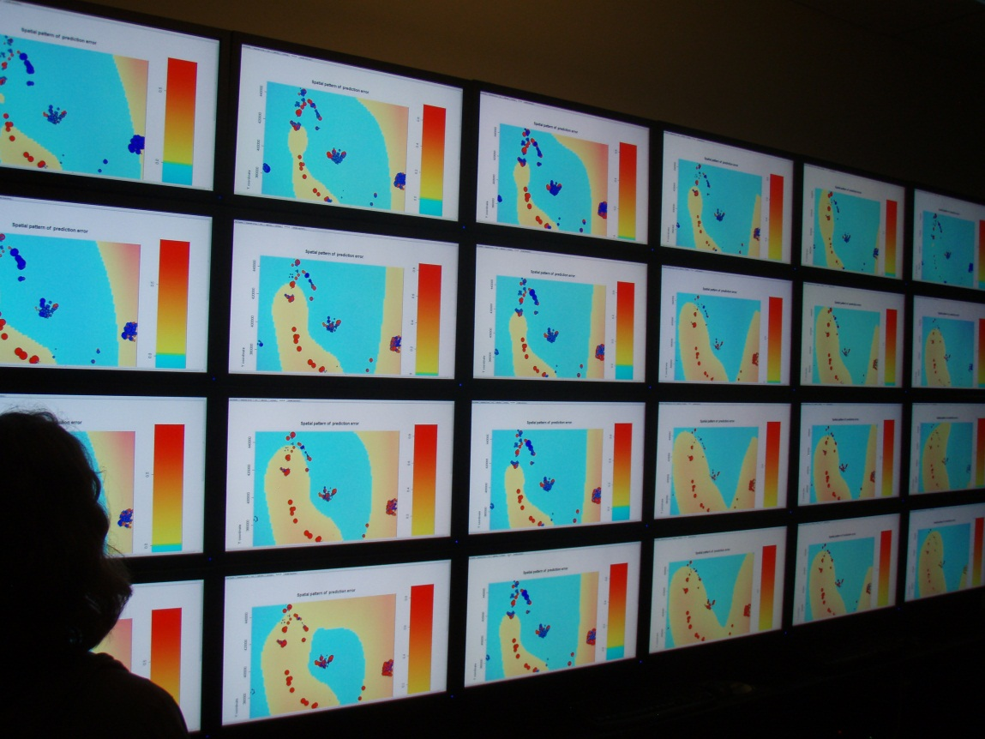
VisWall enabled visualization of results from four background methods by six model algorithms

Slide 12
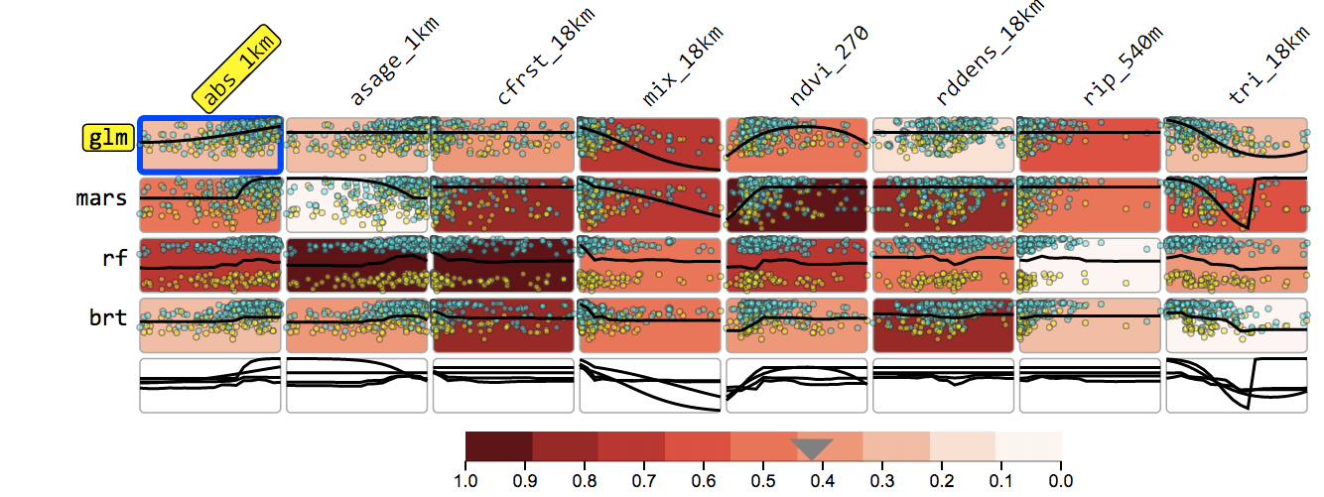
Exploring Response Curves
Notes:
The data are from:
http://sagemap.wr.usgs.gov/wbea.aspx
They are:
a. asage_1km is the proportion of all sagebrush in a 1km moving window.
b. cfrst_18km is the proportion of all coniferous forest in a 18km moving window.
c. mix_18km is the proportion of all mixed shrubland in a 18km moving window.
d. ndvi_270 is average NDVI in a 0.27km moving window.
e. rddens_18km is the road density in a 18km moving window.
f. tri_18km is a topographic ruggedness index at a 18 km scale.
g. abs_1km is the proportion of big sagebrush in a 1km moving window.
h. rip_540 is the proportion of riparian in a 540 m moving window

Slide 13
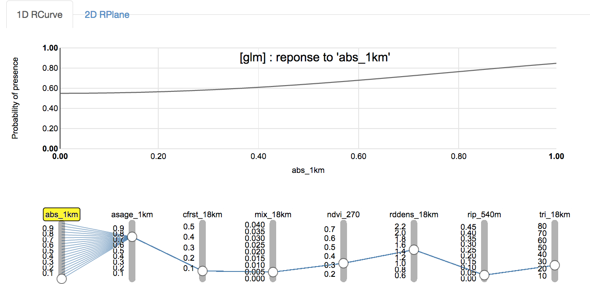

Slide 14
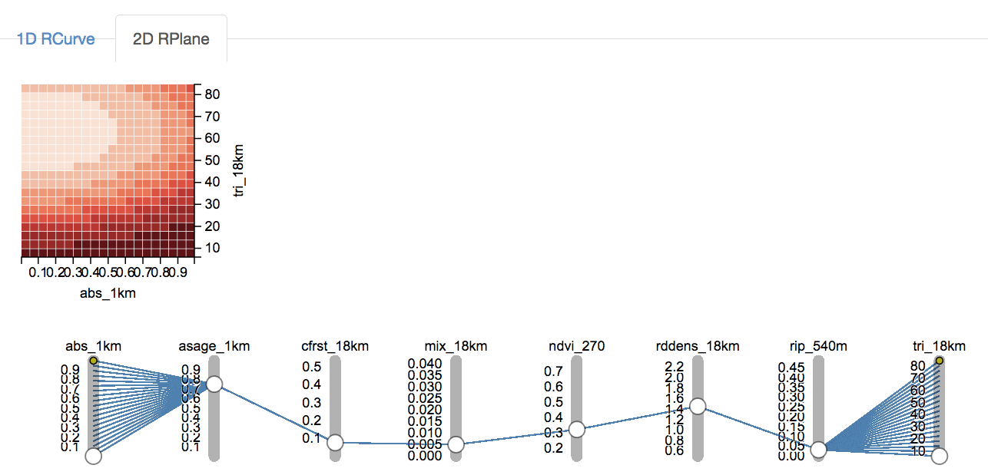

Slide 15
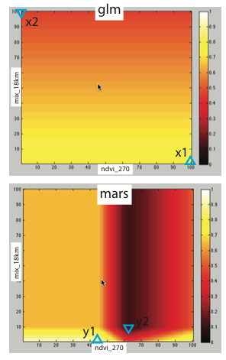
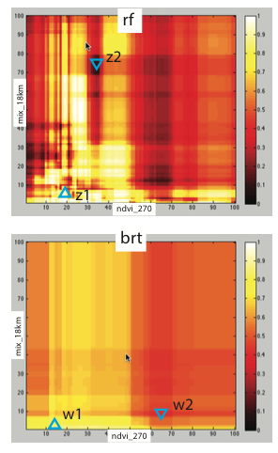
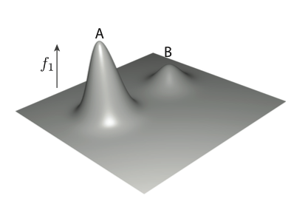
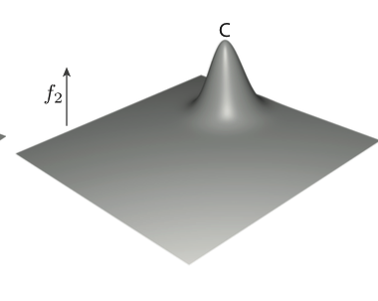
Research on Visualizing Response Curves
Theory
Example
Using Maximum Topology Matching to Explore Differences in Species Distribution Models, Poco et al. VIS 2015.

Slide 16
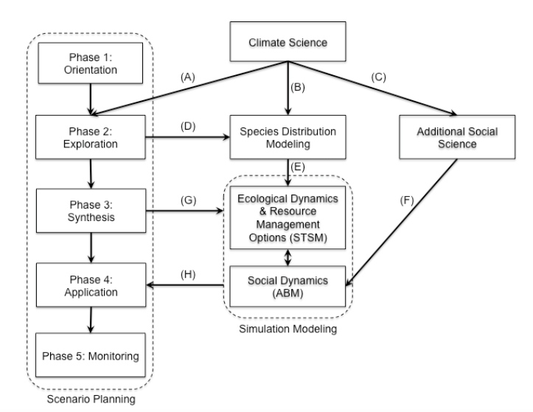
DOI North Central Climate Science Center Integrated Research Tool Framework
NPS Scenario Planning Workshops
NASA Biodiversity Project & SAHM
Paper in press on White Bark Pine (Miller, Hansen, et al)
Miller, B. W., and J. T. Morisette. 2014. Integrating research tools to support the management of social-ecological systems under climate change. Ecology and Society 19(3): 41. http://dx.doi.org/10.5751/ES-06813-190341

Slide 17
Created and maintain credentials on the NASA NAS system at AMES as part of the NEX users group.
Developed Python code to calculate custom climate metrics from the NEX DCP30 CMIP5 data as well as the 800m PRISM time series (bioclimatic variables, seasonal and monthly averages, etc and changing the start and end point of calculation)
Processing multiple models and emission scenarios simultaneously.
Develop local post-processing code ingest int VisTrails.

Slide 18
Outline
Background
Current research themes
Background selection methods
Visualizing response curves
Linking species distribution and simulation modeling
Remote computation of predictor layers
Operational Capacity
Software for Assisted Habitat Modeling (SAHM) training every 6 months
RAM utilization by DOI and other stakeholders
RAM utilization by NASA DEVELOP Central US node
New USGS initiative on Eco-Drought

Slide 19
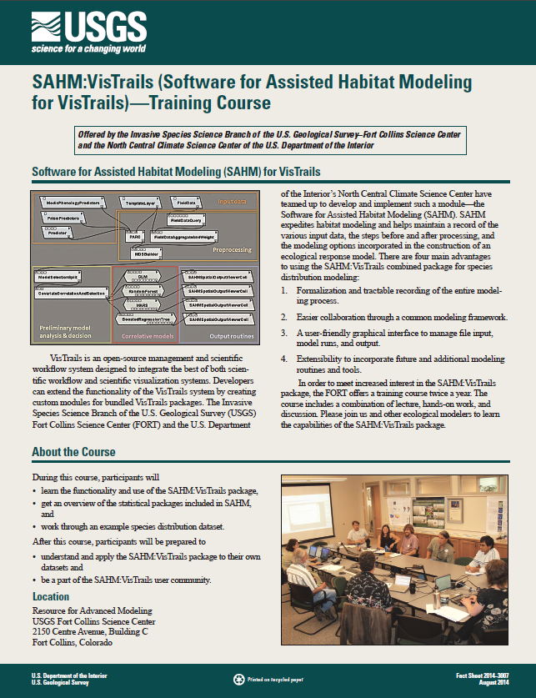
Operational SAHM training
Held biannually
(March and September)
Formal published tutorial
Overview presentations
Notes:
Four trainings since operational with 53 attendees
Pre-operational trainings included June 2012 to NASA DEVELOP students; June 2012 to FWS and Colorado View; Oct 2012 to CSU graduate students; Jan 2013 to mix of government agency representatives

Slide 20
RAM working sessions
FY2012-14 included 31 RAM sessions
Species considered:
Aquatic and terrestrial
Plant, animal, insect
Invasive to Threatened and Endangered
Many agency partners
Considering moving an operational Northern Colorado River drought management webinar to RAM.
*Numbers do not include SAHM trainings or software assistance

Slide 21
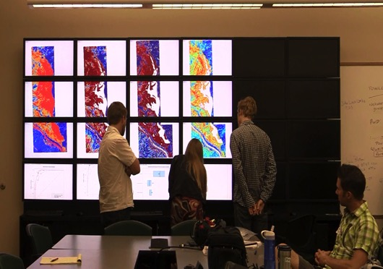
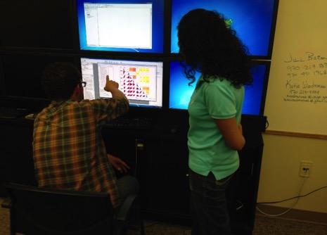
Fort Collins Node
Seven projects have used SAHM and the RAM
Colorado Water Resources I and II (Poudre Wetland Mapping)
Ethiopia Water Resources (Bale Wetland Mapping)
Ethiopia Ecological Forecasting (Prosopis)
Alaska Ecological Forecasting (White Sweet Clover)
Arizona Ecological Forecasting I and II (Tamarisk)
Notes:
Affiliated with both USGS and CSU; served as mentor on several projects between Summer 2012 and now; utilize the RAM and SAHM; several DEVELOPers have attended SAHM training

Slide 22
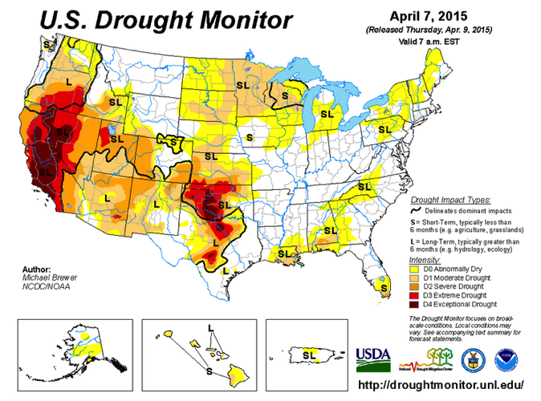
USGS National Climate Change and Wildlife Science Center $3M budget increase
“…The North Central CSC’s visualization tools would allow the Actionable Science Working Groups to evaluate potential impacts of decision regarding drought.
Finally, the NCWSC/CSC Program would develop an online information management system for data, models, and tools that will allow managers to use the integrated modeling of drought to explore impacts of numerous decisions…”

Slide 23
Thanks!

Slide 24
Papers
Published:
Morisette et al., 2013. VisTrails SAHM: visualization and workflow management for species habitat modeling. Ecography 36: 129–135. doi: 10.1111/j.1600-0587.2012.07815.x
Talbert, C., M. Talbert, J. Morisette, D. Koop. 2013. Data Management Challenges in Species Distribution Modeling. IEEE Data Eng. Bull. 36(4)31-40, http://sites.computer.org/debull/A13dec/p31.pdf
Jarnevich, CS, TR Holcombe, EM Bella, ML Carlson, G Graziano, M Lamb, SS Seefeldt, and JT Morisette. Cross-Scale Assessment of Potential Habitat Shifts in a Rapidly Changing Climate. Invasive Plant Science and Management 2014 7:491–502.
Rose, RA, D Byler, JR Eastman,…, JT Morisette, et al., 2014. Ten Ways Remote Sensing Can Contribute to Conservation, Conservation Biology, DOI: 10.1111/cobi.12397
Jarnevich, CS, WE Esaias, PL Ma, JT Morisette, JE Nickeson, TJ Stohlgren, TR Holcombe, JM Nightingale, RE Wolfe, B Tan, 2013. Regional distribution models with lack of proximate predictors: Africanized honeybees expanding north, Diversity and Distributions, DOI: 10.1111/ddi.12143.
Submitted:
Using Maximum Topology Matching to Explore Differences in Species Distribution Models, Poco et al. VIS 2015.
In prep:
The effects of availability on interpretation in studies without absence data, Jarnevich et al.
.

